Slide 1
WEB APPLICATION DEVELOPMENT TRAINING
INTRODUCTION TO JQUERY

Slide 2
The querySelector() method
querySelector() was introduced in the Selectors API.
Returns the first Element within the document (using depth-first pre-order traversal of the document's by first element in document
Syntax is element = document.querySelector(selectors);
element is an Element object.
selectors is a string containing one or more CSS selectors separated by commas
document.querySelector("a") will return the first <a> in the document
Ex: display the id of the first <a> tag on your page

Slide 3
Javascript Anonymous Function
You have learnt in JS module that functions are created following the syntax :
function myfunx(){
  // do some stuff here
  }
Such a function is known as a ‘named’ function
Other way of creating a function without giving it a name is the anonymous function.
Syntax is: function (){
// do some stuff here
}

Slide 4
Javascript Anonymous Function
Since the function does not have a name, it can be assigned to a variable or passed to another function as an argument
var x= function (){ // do some stuff here }
  var x= document.getElementById ("a");
  x.onclick = function() {
  alert("I ve been clicked");
  };

Slide 5
Callback Function
A callback is a JavaScript function passed to some method as an argument or option.
A callback function, is a function that is passed to another function (let's call this other function “otherFunction”) as a parameter, and the callback function is called (or executed) inside the otherFunction.
element.onclick = function(){
alert(“Hi”);
}
In the above, the callback function alerts Hi
$("#myform").submit(function() { return false; });

Slide 6
Callback Function
Callback functions are derived from a programming paradigm known as functional programming.
At a fundamental level, functional programming specifies the use of functions as arguments.
Note that the callback function is not executed immediately. It is “called back” (hence the name) at some specified point inside the containing function’s body
Used in Jquery a lot

Slide 7
The Event Object
HTML DOM events allow JavaScript to register different event handlers on elements in an HTML document
The event object contains a lot of useful information on what has happened.
Events are normally used in combination with functions, and the function will not be executed before the event occurs (such as when a user clicks a button).
See a full list of DOM events at https://www.w3schools.com/jsref/dom_obj_event.asp

Slide 8
The Event Object
The event object is always passed to the handler
Different types of events provide different properties. For example, the onclick event object contains:
  event.target - the reference to clicked element.
  event.clientX / event.clientY - coordinates of the pointer at the moment of click.
Some properties are generic: Example event.type - gives you the type of the event, like “click”
element.onmouseover = function(event) {
alert("Hi"+ event.target);
}
Notes:
IE uses event.srcElement instead of event.target

Slide 9
The Event Object
Browsers which follow W3C standards always pass the event object as the first argument for the handler
element.onclick = function(event){
// process data from event
}
function doSomething(event){
// we've got the event
}
element.onclick = doSomething

Slide 10
Introduction to Jquery
jQuery is a fast and concise JavaScript Library created by John Resig in 2006 with a nice motto − Write less, do more.
Document.getElementsByTagName(‘p’); $(‘p’)
The above will both achieve the same thing of selecting the HTML element <p> tag
To use jquery, you have to include the library file either from a local directory or directly from the CDN (Content Delivery Network) – Google and Microsoft Popular
<script src="https://ajax.googleapis.com/ajax/libs/jquery/3.1.1/jquery.min.js"></script>

Slide 11
Introduction to Jquery
jQuery is a framework built using JavaScript capabilities.
So while developing your applications using jQuery, you can use all the functions and other capabilities available in JavaScript.

Slide 12
Jquery Syntax
The jQuery syntax is tailor-made for selecting HTML elements and performing some action on the element(s).
Basic syntax is: $(selector).action()
A $ sign to define/access jQuery
A (selector) to "query (or find)" HTML elements
A jQuery action() to be performed on the element(s)

Slide 13
$( document ).ready() Function
It is good practice to wait for the document to be fully loaded and ready before working with it
A page can't be manipulated safely until the document is "ready.“ jQuery detects this state of readiness for you.
Code included inside $( document ).ready() will only run once the page DOM is ready for JavaScript code to execute.
The shorthand for $( document ).ready() is $()
The method can take as parameter either a named or anonymous function
Notes:
$() for $( document ).ready()

Slide 14
$( document ).ready()
function myFunction (){
JS codes here
}
$(document ).ready(myfunction(){
});
$(myFunction(){ // jQuery methods go here...});
Notes:
$() for $( document ).ready()
When the document is ready, execute the function myFunction()

Slide 15
Jquery Selectors
Selectors are used to select one or more HTML elements using jQuery.
Once an element is selected then we can perform various operations on that selected element.
jQuery selectors are used to "find" (or select) HTML elements based on their name, id, classes, types, attributes, values
It's based on the existing CSS Selectors, and in addition, it has some own custom selectors

Slide 16
Jquery Selectors
The jQuery element selector selects elements based on the element name. eg $("p")
The jQuery #id selector uses the id attribute of an HTML tag to find the specific element eg $("#test")
To find elements with a specific class, write a period character, followed by the name of the class: eg $(“.demo”)

Slide 17
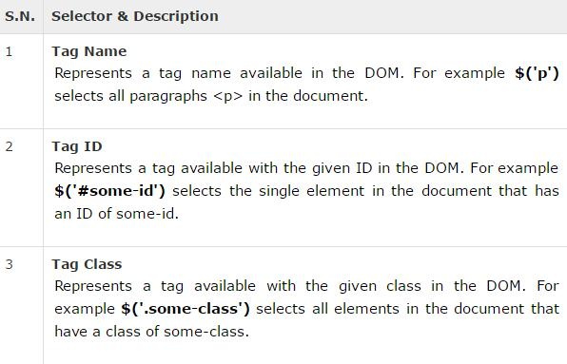

Slide 18
Jquery Event methods
jQuery provides simple methods for attaching event handlers to selections. When an event occurs, the provided function is executed
You can prevent the default behavior by calling event.preventDefault() in the event handler
When you attach an event to an element via the event method, the next is to determine what happens to the element as a result, by passing an anonymous function to the method.

Slide 19
Jquery Event methods
Step1: Attach an event to an element
$("p").click();
Step2: Determine what happens to the element when that event happens by passing an anonymous function as a parameter to the event
$("p").click(function(){
// action goes here!!
$(this).hide();
});
$("#demo").mouseenter(function(){
alert("You Just entered by demo tag");
});

Slide 20
Jquery Event Methods
Some events can take up to 2 parameters (2 anonymous functions) .
$("#p1").hover(function(){
alert("You entered p1!");
},function(){
alert("Bye! You now leave p1!");
});

Slide 21
JQUERY EVENTS
The hover() method takes two functions and is a combination of the mouseenter() and mouseleave() methods.
The first function is executed when the mouse enters the HTML element, and the second function is executed when the mouse leaves the HTML element
$(‘p’).hover(function(){},function(){})
The Blur function is executed when the form field loses focus:

Slide 22
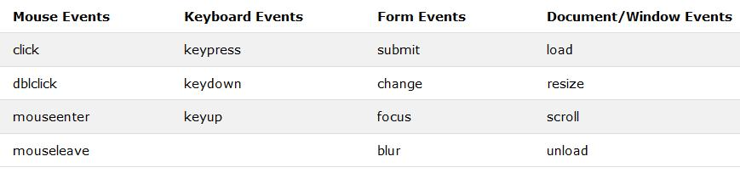
JQUERY EVENTS

Slide 23
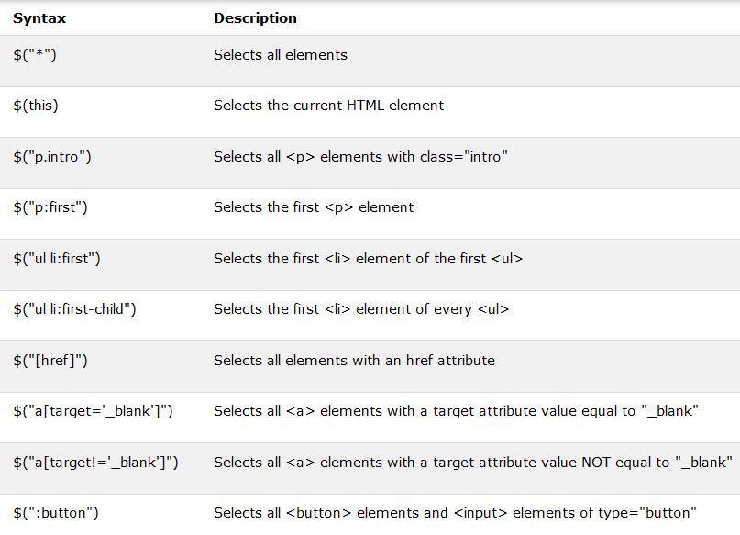
More Jquery Selectors
In addition to the id and class and tag name selectors, Jquery borrows from CSS 3 and also adds its own selectors.

Slide 24
JQUERY DOM MANIPULATION
Some of the most basic components we can manipulate when it comes to DOM elements are the properties and attributes assigned to those elements
The attr() method can be used to either fetch the value of an attribute from the first element in the matched set or set attribute values onto all matched elements.
jQuery gives us the means to easily manipulate an element's attributes and gives us access to the element so that we can also change its properties

Slide 25
JQUERY DOM MANIPULATION
To alter the structure of your HTML elements

Slide 26
JQUERY DOM MANIPULATION
The attr(name, value) method can be used to set the named attribute onto all elements in the wrapped set using the passed value
removeAttr( name ): Remove an attribute from each of the matched elements.
hasClass( class ): Returns true if the specified class is present on at least one of the set of matched elements.
removeClass( class ):Removes all or the specified class

Slide 27
Jquery DOM Manipulation
text() - Sets or returns the text content of selected elements. Example:
var x = $("#head").text(); alert(x);
html() - Sets or returns the content of selected elements (including HTML markup)
var x = $("#head").html(); alert(x);
the jQuery val() method allows you to get the value of an input element
The jQuery attr() method is used to get attribute values. Syntax is $(element).attr(“the attribute”)
alert($("#link").attr("href"));
Notes:
<h1 id="head"><a href="#“ id=“link”>I am a heading</a></h1>

Slide 28
Jquery DOM Manipulation
The same three methods : text() html() val() can also be used to set contents for HTML selectors
$("#head").text(“The new heading!");
Exercise: Set the background of your input field to yellow as soon as it receives focus
Notes:
<h1 id="head"><a href="#“ id=“link”>I am a heading</a></h1>

Slide 29
Manipulating CSS with Jquery
addClass() - Adds one or more classes to the selected elements
$(element).addClass(“classname”);
You can also specify multiple classes within the addClass() method by separating the clases with space : $(element).addClass(“classname class2”);
You can add the same class to multiple elements by separating the elements with comma $(element,element).addClass(“classname class2”);

Slide 30
Useful Form Handlers/ Jquery Methods
Blur(): The blur event is sent to an element when it loses focus, the method can be used to attach an event to an element when this happens
Submit() : The submit event is sent to an element when the user is attempting to submit a form
Submit() can only be attached to <form> elements. Forms can be submitted either by clicking an explicit <input type="submit">, <input type="image">, or <button type="submit">

Slide 31
Jquery Assignment
Using Jquery, design a form validation function
Your function should check if the username and password fields are blank, if they are, change the border color of the input fields to red. You may go further to append <span>This field is required</span> to the element.
Hint: addClass(), .attr, .val()

